Slide 1
SQL AND EXCEL PORTFOLIO PROJECT
Pizza Sales Analysis:
SQL TASKS:
1.Importing data into MS SQL Server
2.Database creation
3.Query Writing
4.Report Generation
EXCEL TASKS:
1.Connecting to MS SQL Server
2.Data cleansing
3.Data Processing
4.Data Analysis
5.Data Visualization
6.Report/Dashboard

Slide 2
PROBLEM STATEMENT
KPI’S Requirement:
Total Revenue
Average Order Value
Total Pizzas sold
Total Orders
Average Pizzas Per Order
Chart Requirement:
Daily Trend For Total Orders
Hourly Trend For Total Orders
Percentage of Sales by Pizza Category
Percentage of sales by Pizza Size
Total pizza Sold by Pizza Category
Top 5 Pizza Sellers
Top 5 Worst Sellers

Slide 3
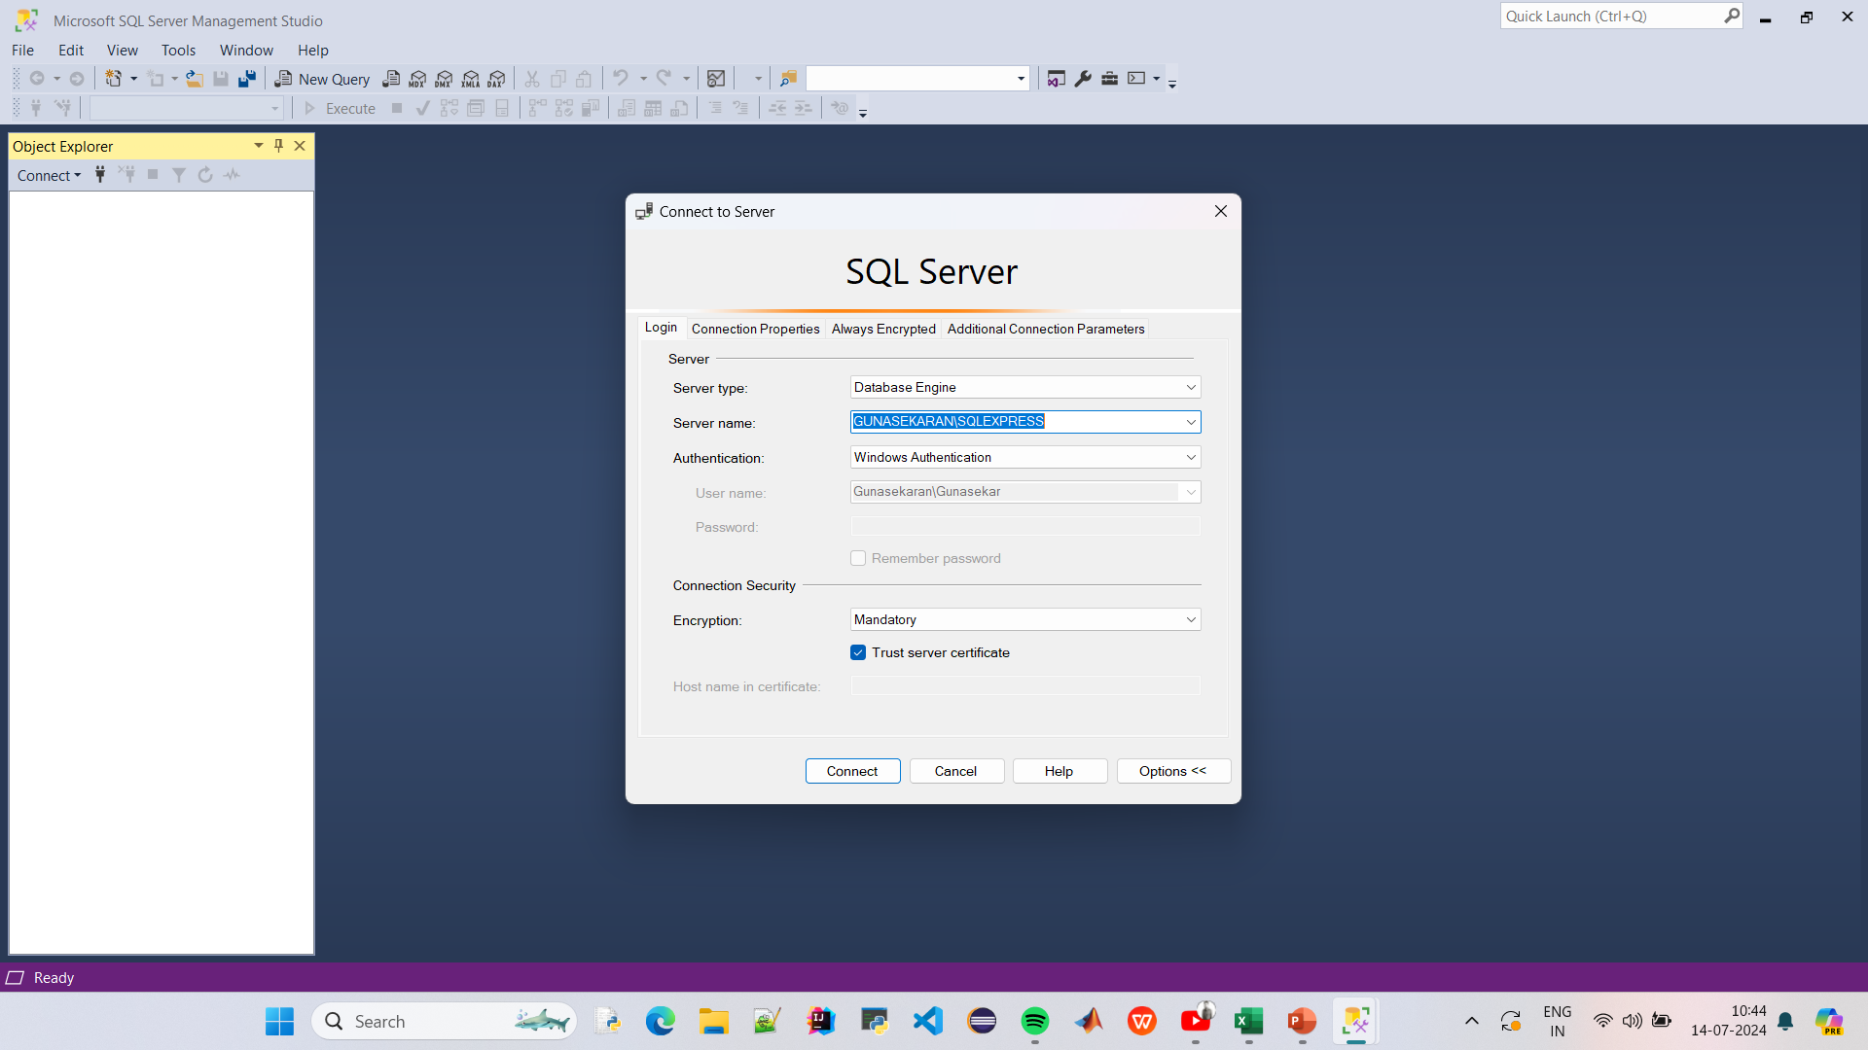

Slide 4
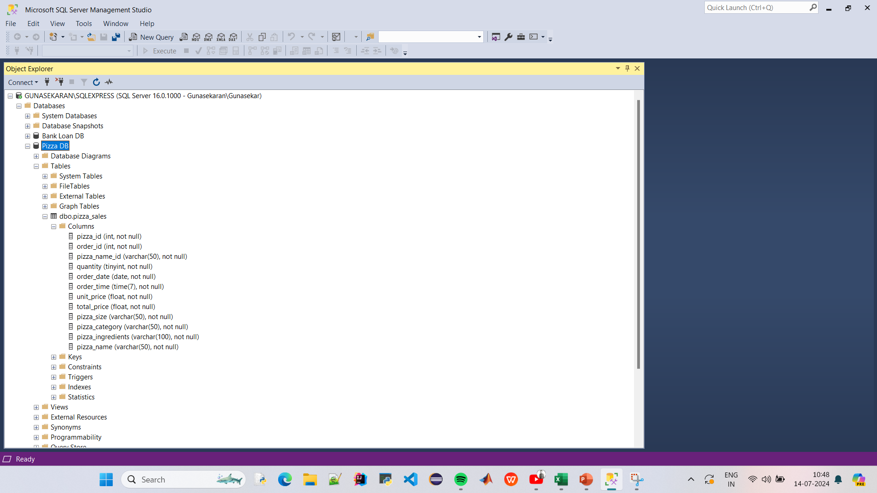

Slide 5
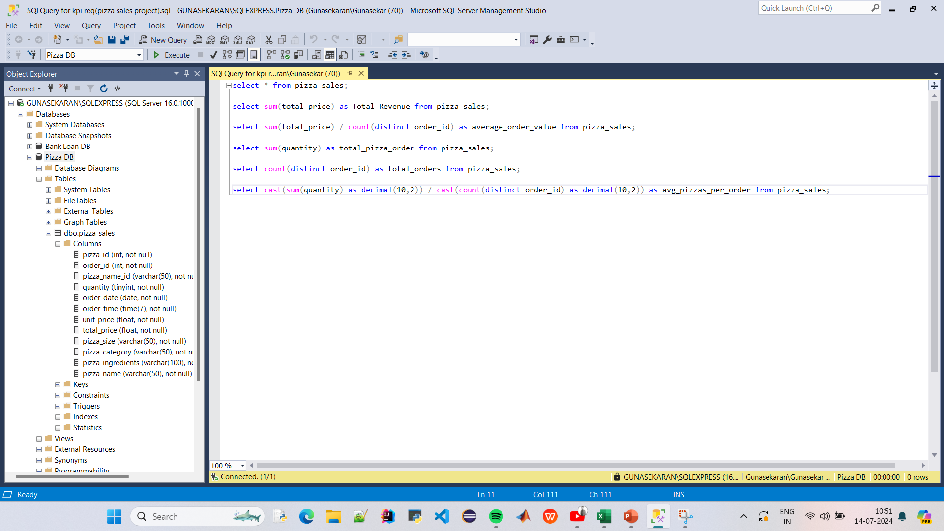

Slide 6
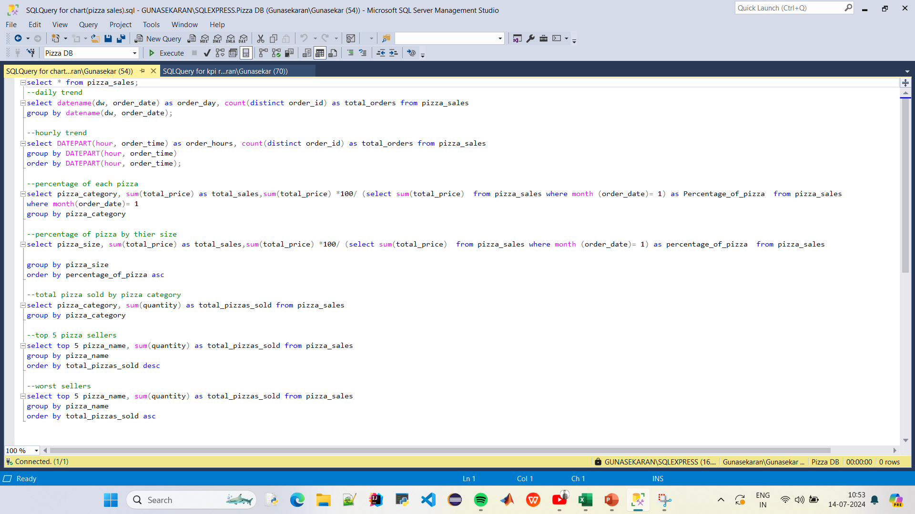

Slide 7
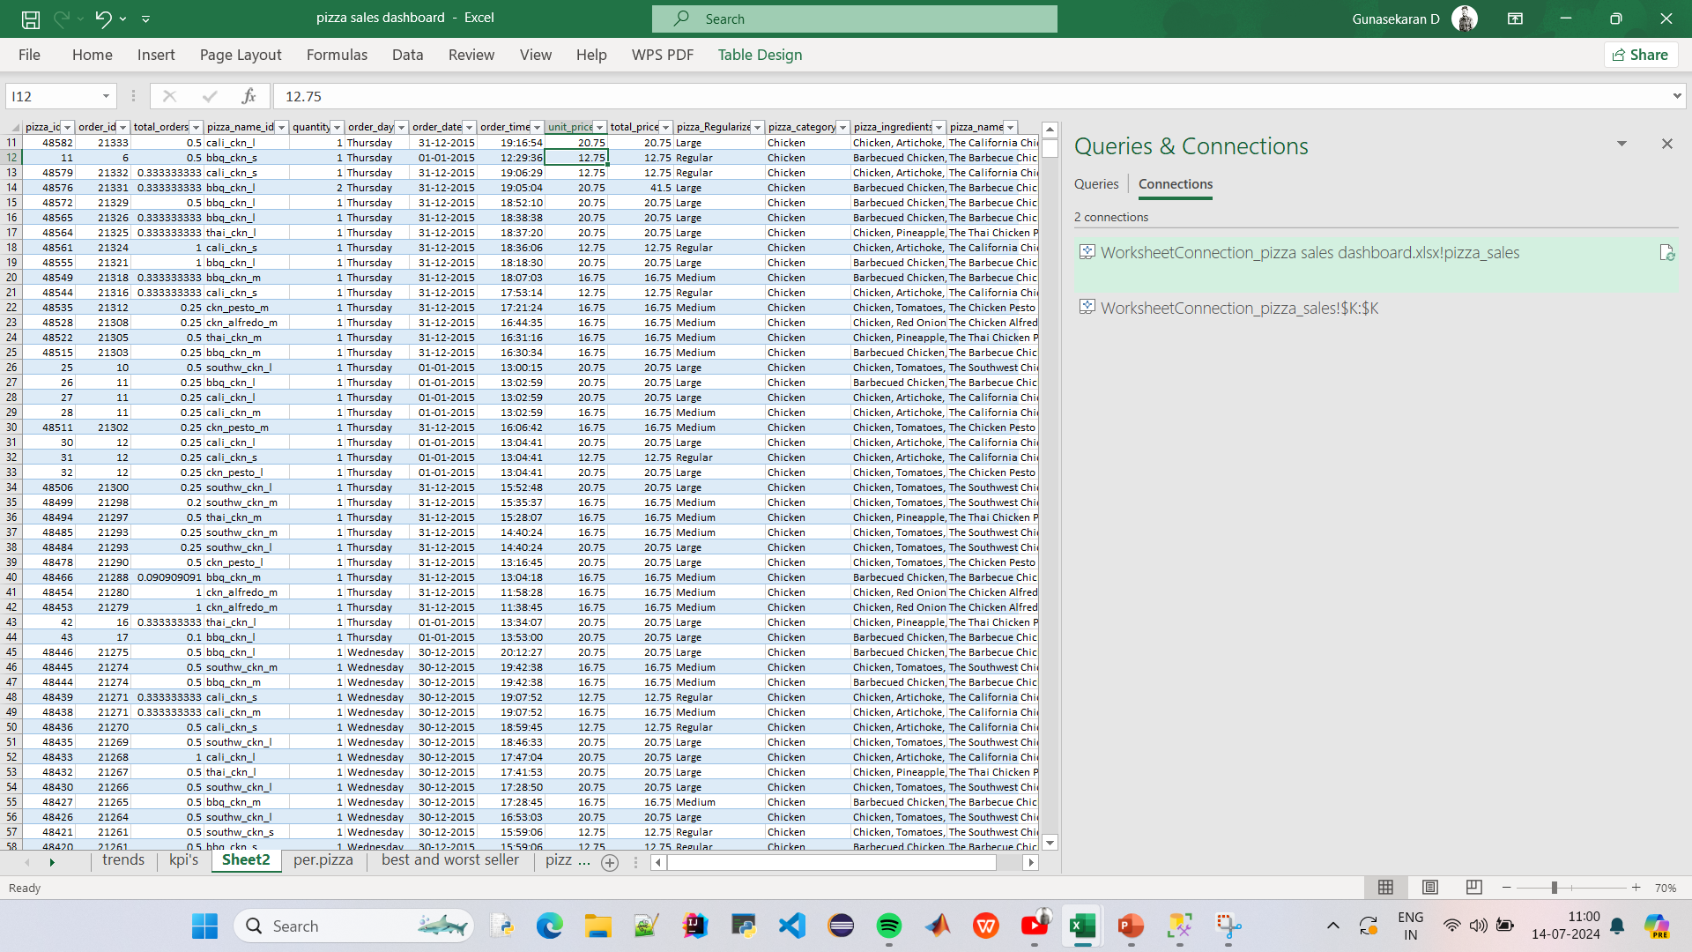

Slide 8
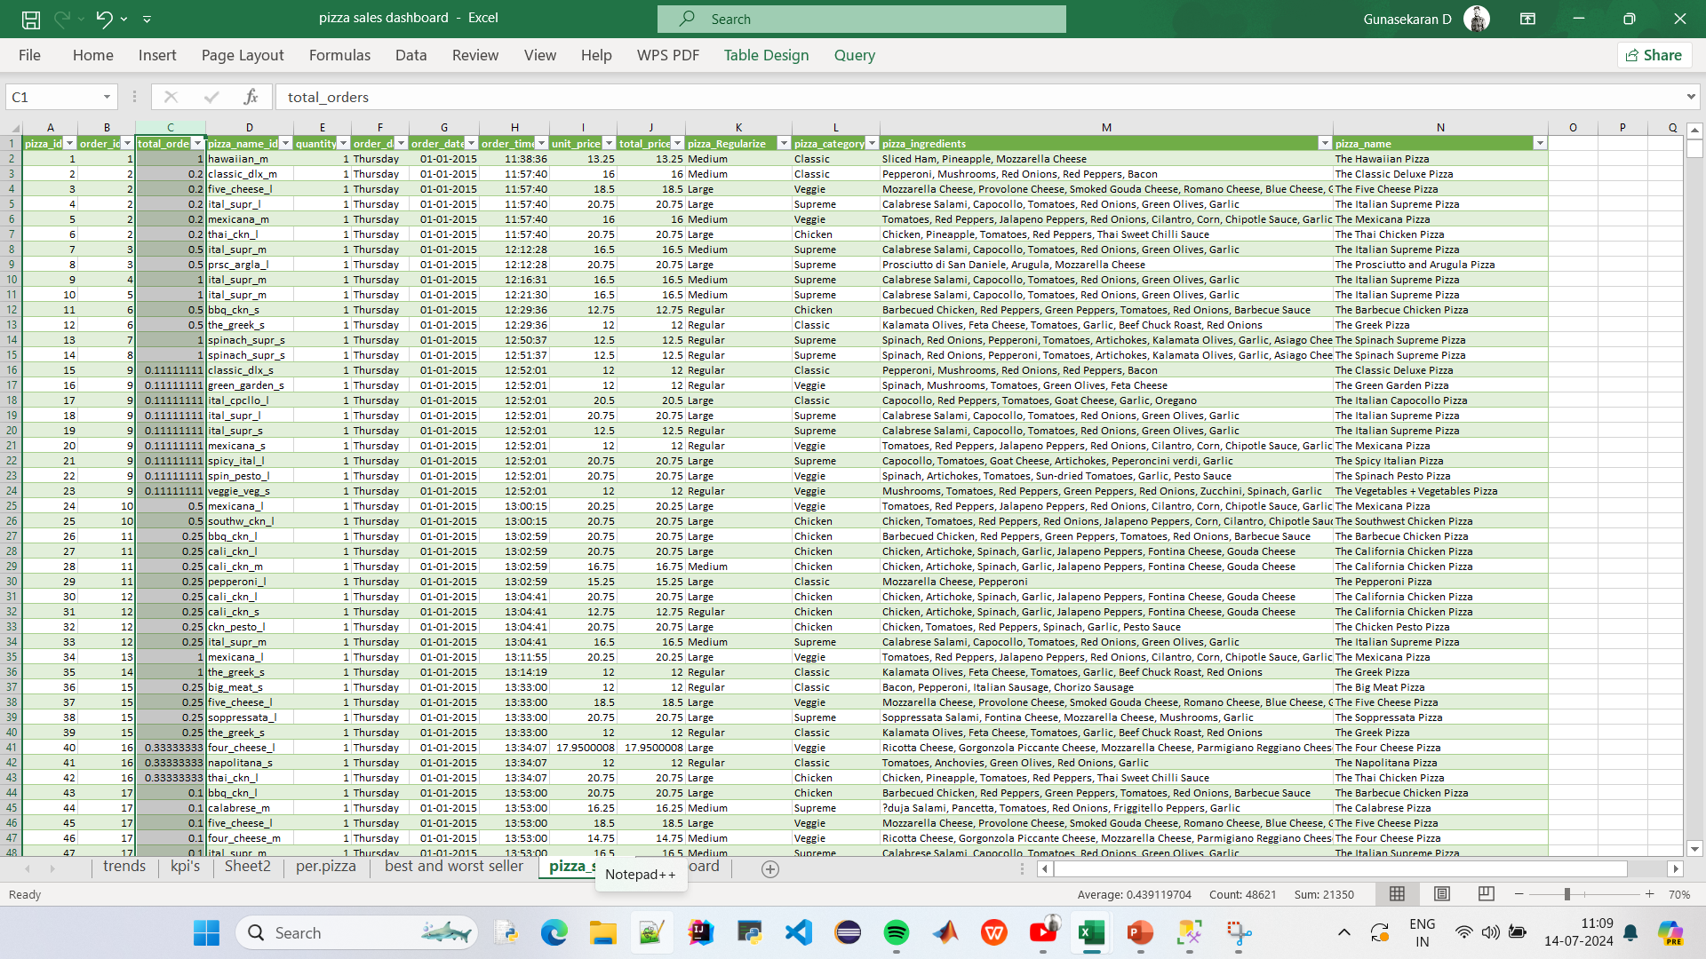

Slide 9
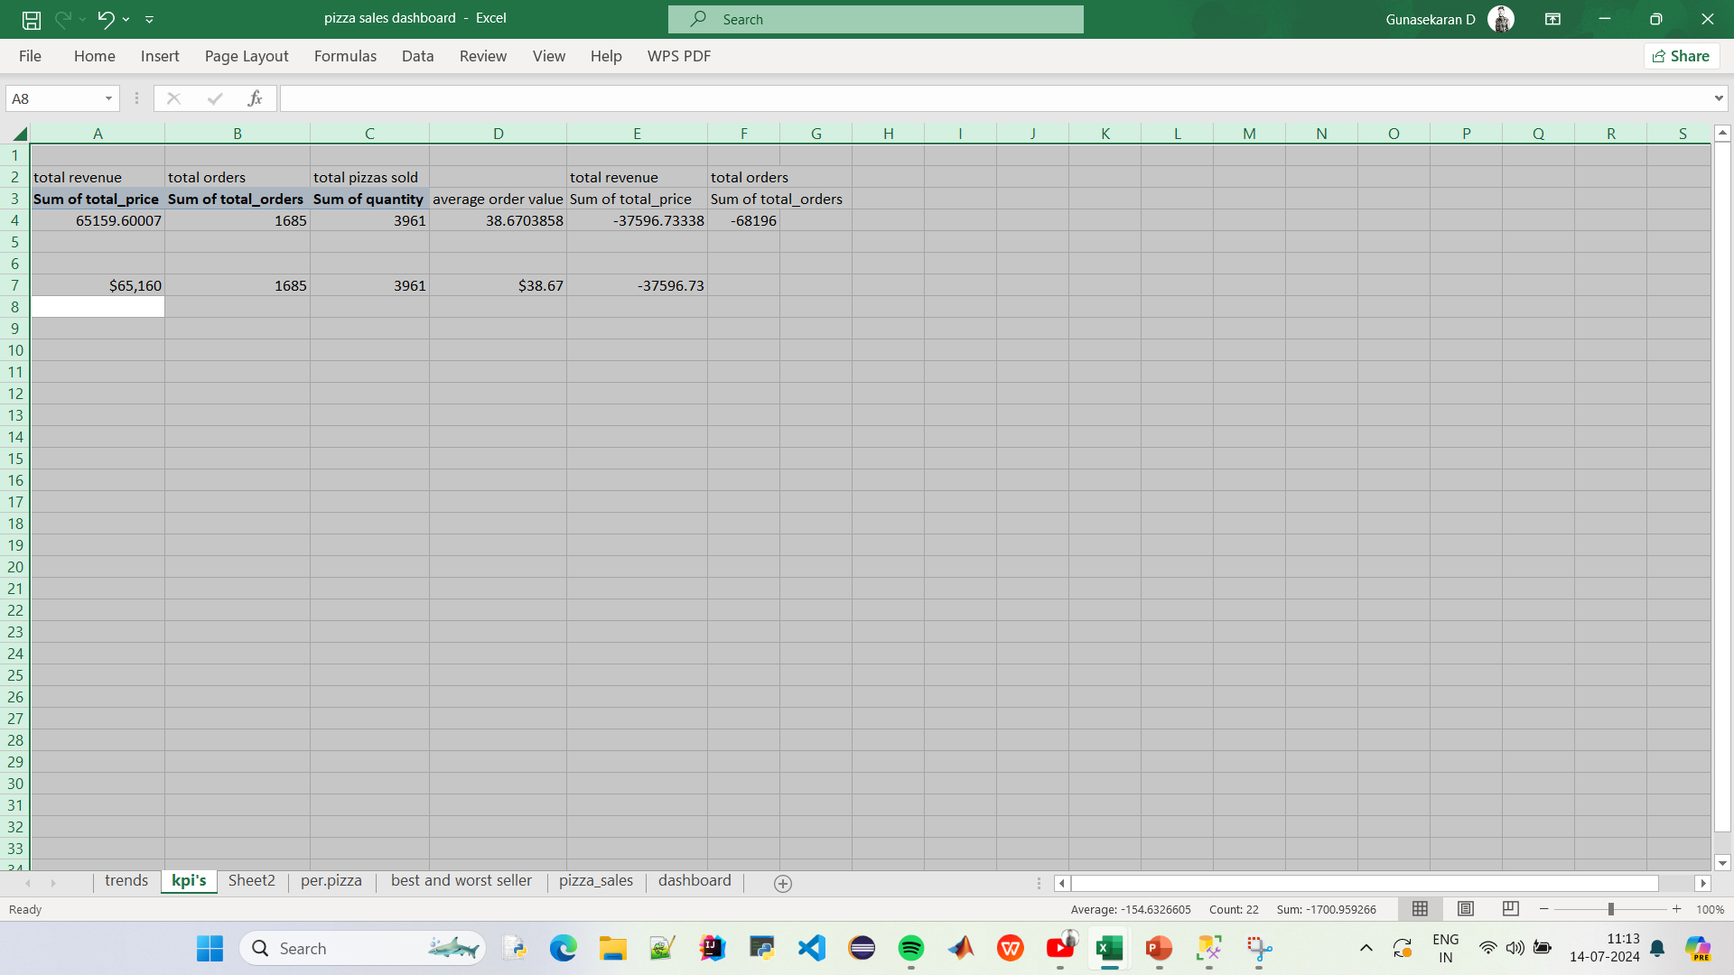
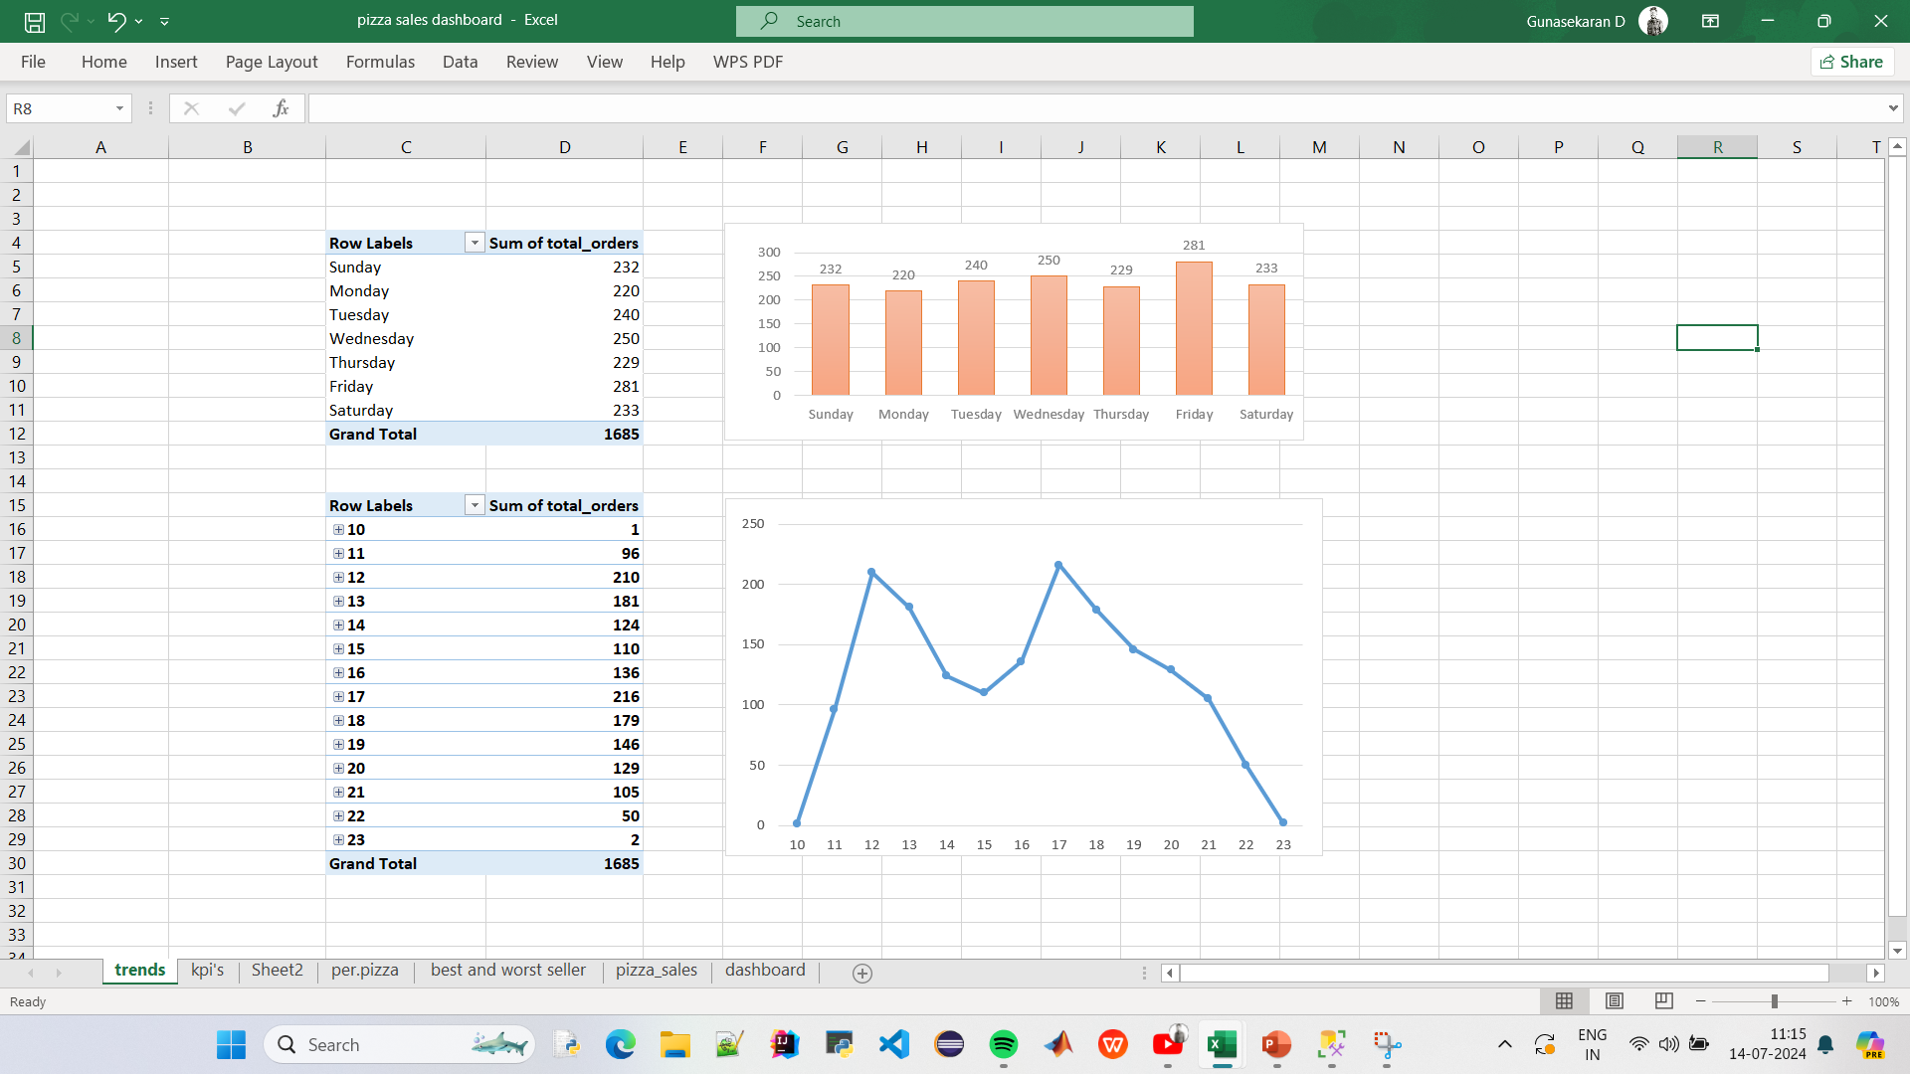

Slide 10
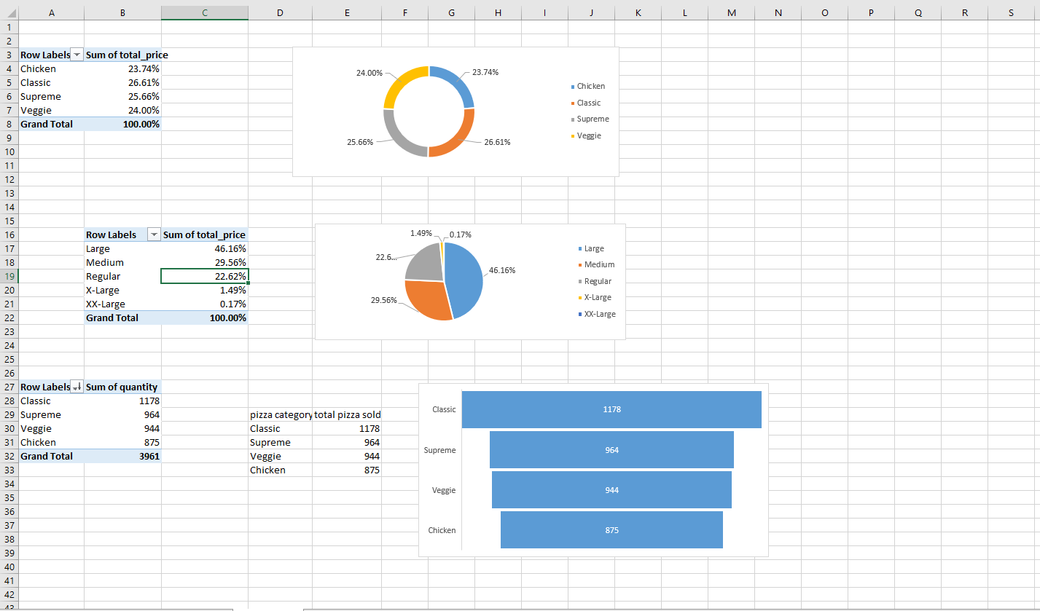

Slide 11
